Slide 1
DESIGN AND IMPLEMENTATION OF A DASHBOARD PAYROLL SYSTEM
OLUBUSAYO OLABISI
IFEANYI OKAFOR
NATALEE EVANS
ABDULAZIZ AL BIMANI

Slide 2
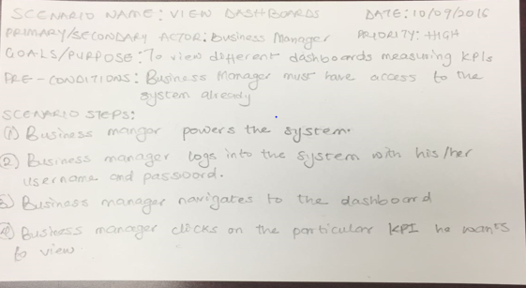
VIEW DASHBOARD USER STORY

Slide 3
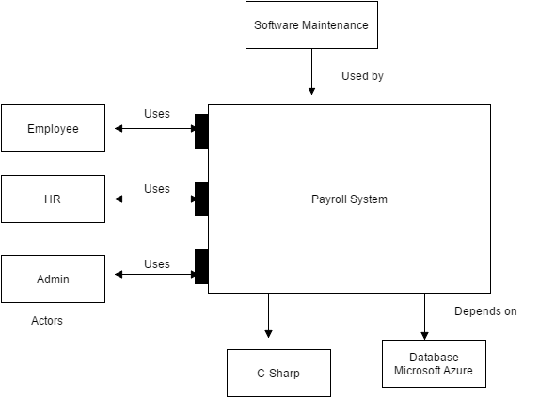
ARCHITECTURE DIAGRAM

Slide 4
VIEW DASHBOARD-ACTIVITY DIAGRAM

Slide 5
CLASS DIAGRAM

Slide 6
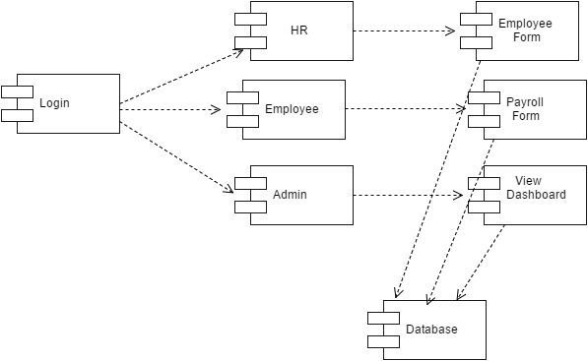
COMPONENT DIAGRAM

Slide 7
DATABASE DIAGRAM

Slide 8
PAYROLL SCREEN

Slide 9
HR SCREEN

Slide 10
Repository - Github

Slide 11

Questions

